Slide 1


Find Me Internship Website
Subject: CS348 SGP 3
Internal Mentor: Assistant Prof Bela Shah
Group members:
20CS057 Shivam Patel
20CS063 Hemil Patoliya
20CS065 Kishan Prajapati
20CS068 Pruthvi Raj

Slide 2
Content
Introduction
Problem Statement
Project Scope
Comparative study with similar projects
Salient features
Functional and Non-functional Requirements
SDLC
Flowchart/ System flow
Implementation Screenshots
Modules
Technology to be used

Slide 3
Introduction
“Find Me Internship” is a website developed for CSE students to help them find the internship.
The system will serve as a platform for students to access the list of available companies which provide internship to students, check their reviews, apply for them and much more, making the regular hectic and time consuming process of looking for an ideal internship effortless.

Slide 4
Problem statement
“The purpose of this project is to reduce the confusion of choosing an ideal internship for students by providing them all the necessary details of the company and their reviews.”
Problems currently faced which looking for internship:
Finding list of available companies for internship.
Checking company profile, their requirements, location through different sources.
Not many reviews available of company.
Procedure to do internship in company apart from mentioned in university company list.

Slide 5
Project Scope
There are three main scope of this project are:
Developing a website where students will easily be able to find the internships based on their interest, location and technology.
Making reviews of past students available for students who are looking for internship in listed company.
Approving new companies for internship and managing companies list for Admin.

Slide 6
Salient features
Students view
View companies detailed profile including location, prefered technology, requirements, internship categorie (free/paid), contact information .
Add Company internship reviews.
View reviews and rating of company.
Apply for approval of internship in company which is unlisted.
Admin View
Approval of new company.
Add, Remove, Manage companies profile and list.
Add Admin for Super Admin user
View students review and know their experience about a particular company

Slide 7
Comparative Study with Similar Projects
Although, there are number of websites and application which help students as well as professionals to find internship like Internshala but our website is specifically for CHARUSAT university which includes numerous companies which are collaborated with CHARUSAT.
This website not only gives information about companies which provide internship
but also it shows students review who already did internship in those companies.

Slide 8
Functional
Non-functional Requirements
User and Admin Register/Login system.
Company list
View Company profile
Add review
View company review
Apply for unlisted company
Add/Remove company for Admin
Grey, yellow and white color palette
Easy flow and navigation
Responsive web page
Secure login/Registration system

Slide 9
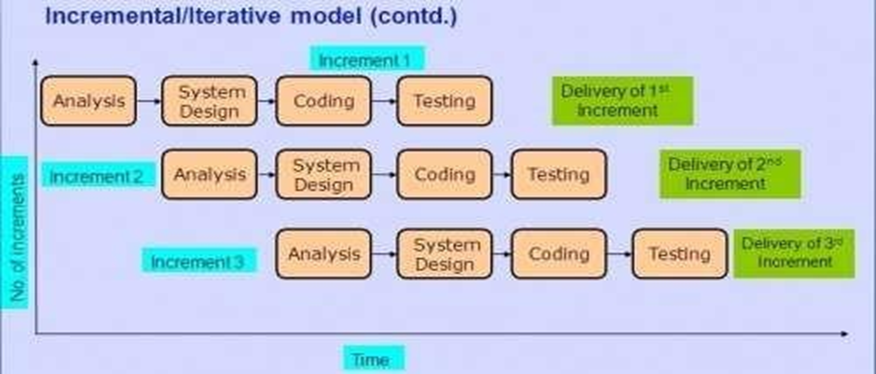
SDLC: Incremental Model
The software development life cycle model used for developing this project is Incremental model

Slide 10
SDLC
In incremental model the entire project is divided into smaller more easily managed modules. Each module passes through requirements, design, implementation and testing phases.A working version of software is produced during each module.
Requirement Analysis: First the requirements of the customer regarding module is noted down and analysis is done on the features.
System Design: Second step is the system design where the team decides the layout of the module based on the requirements.
Code: The coding of software starts in this step.
Testing: Once the system is deployed, it goes through the testing phase.

Slide 11
Modules
Dashboard:
The dashboard will consist of grid of Companies profile image along with the contact information and rating given by students who did their internship from that company.
Registration and Login:
The registration and login feature is provided for the access of further pages on user as well as admin side.
Company list and Profile:
This module consists of list of available company and profile of each company which will gives detailed information about the company and requirements.

Slide 12
Modules
Add and View Company review:
The module provides the feature to user to add their review regarding company and allow all the users to view the reviews of company which are already entered by students.
Company Approval:
The given feature can be used by student in case they want to apply for internship in company which is not mentioned in company list. The student can fill up the company approval form and it will be sent to admin for approval.
Add and Remove Company:
This module allows admin to add the new company to company list by filling up the required details or remove the company from list.

Slide 13
Flowchart / System Flow
https://drive.google.com/file/d/1uYWB8BpUmCHeUfSmusHhgwLzsYo4_aDK/view?usp=sharing

Slide 14
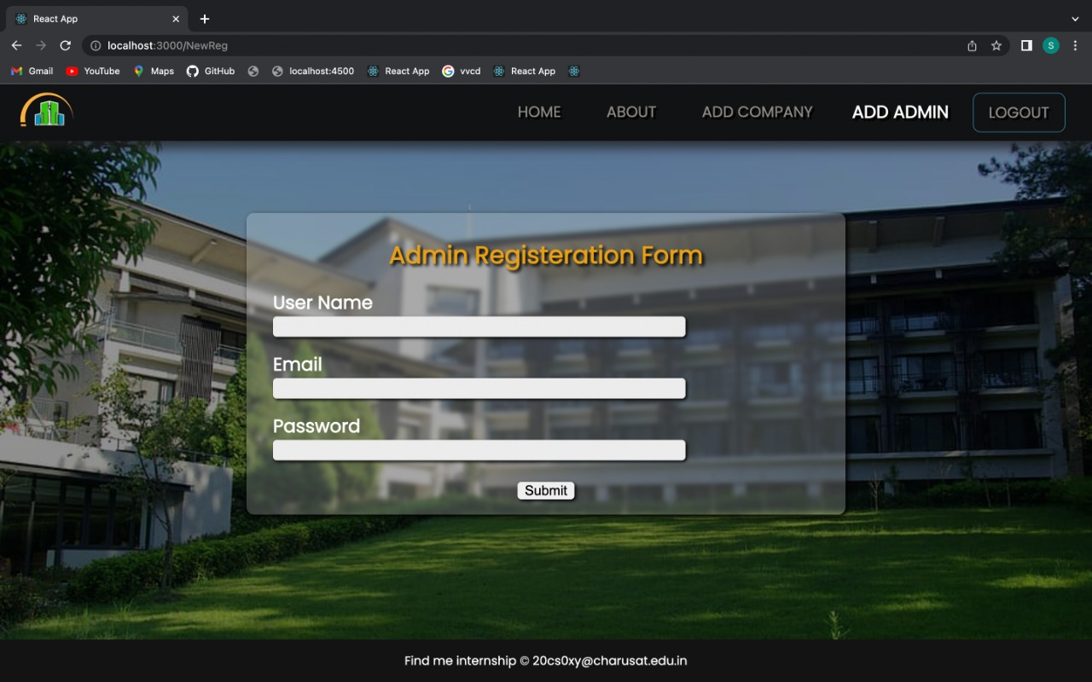
Implementation screenshots
Admin Registration

Slide 15
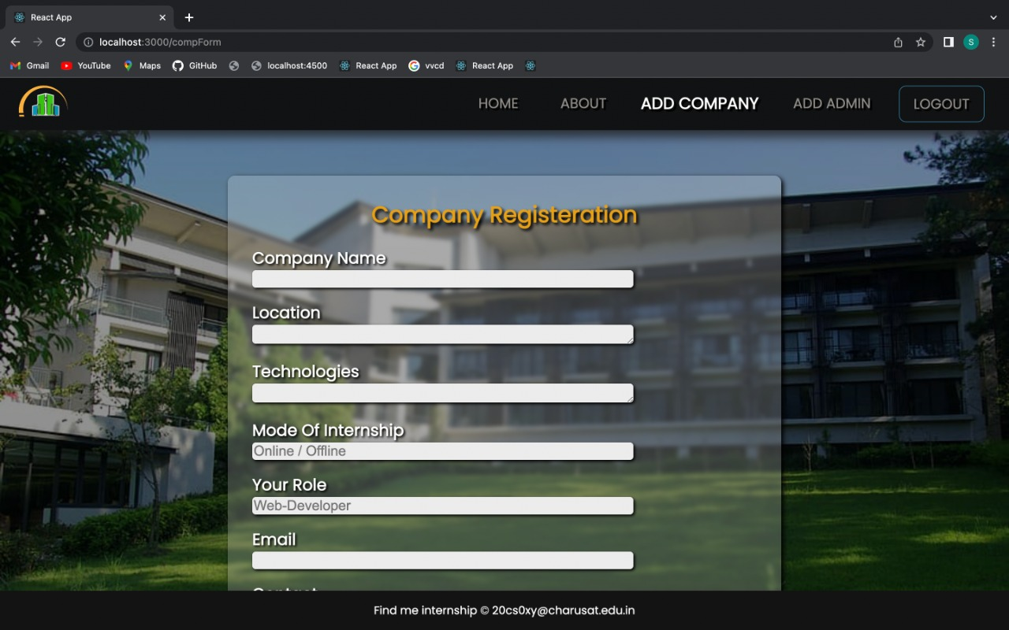
Add company

Slide 16
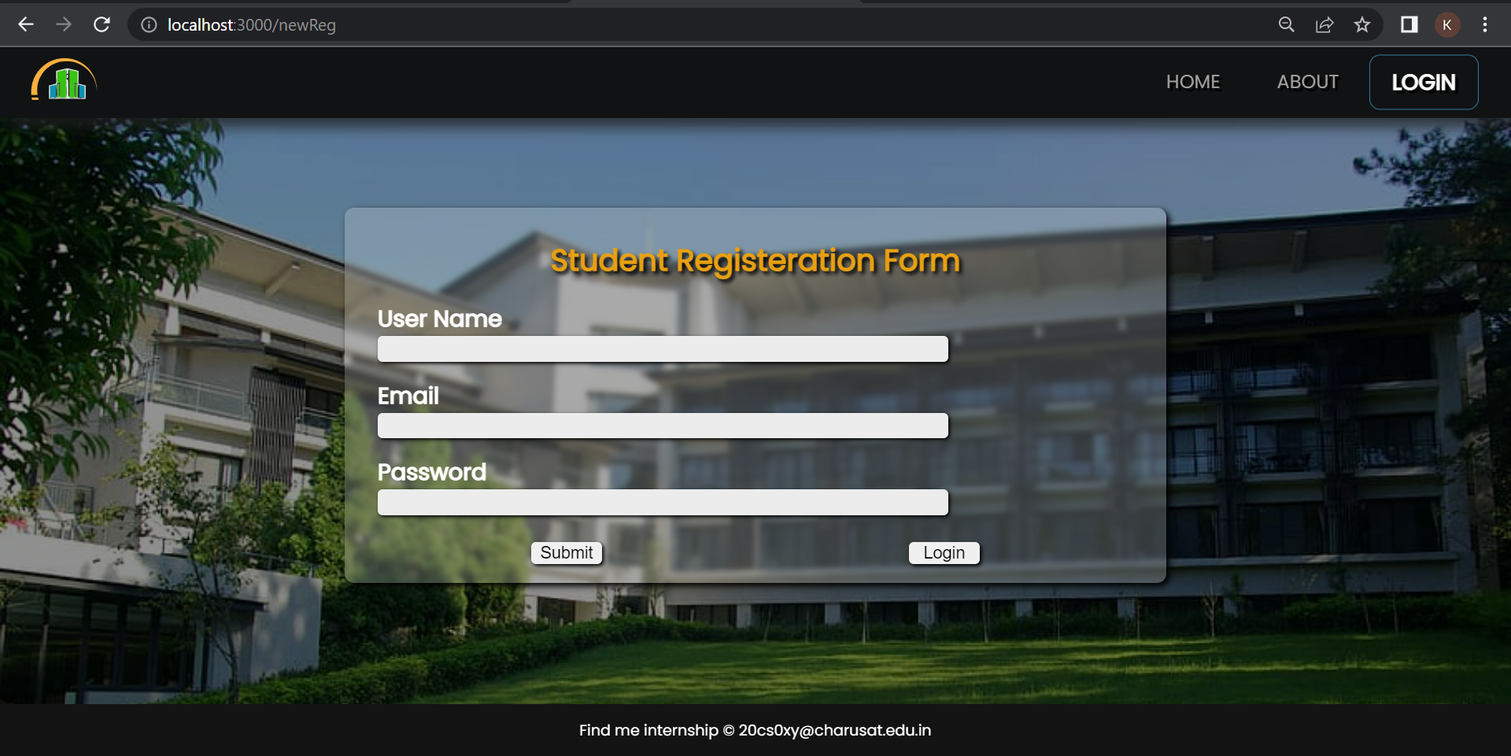
Student Registration

Slide 17
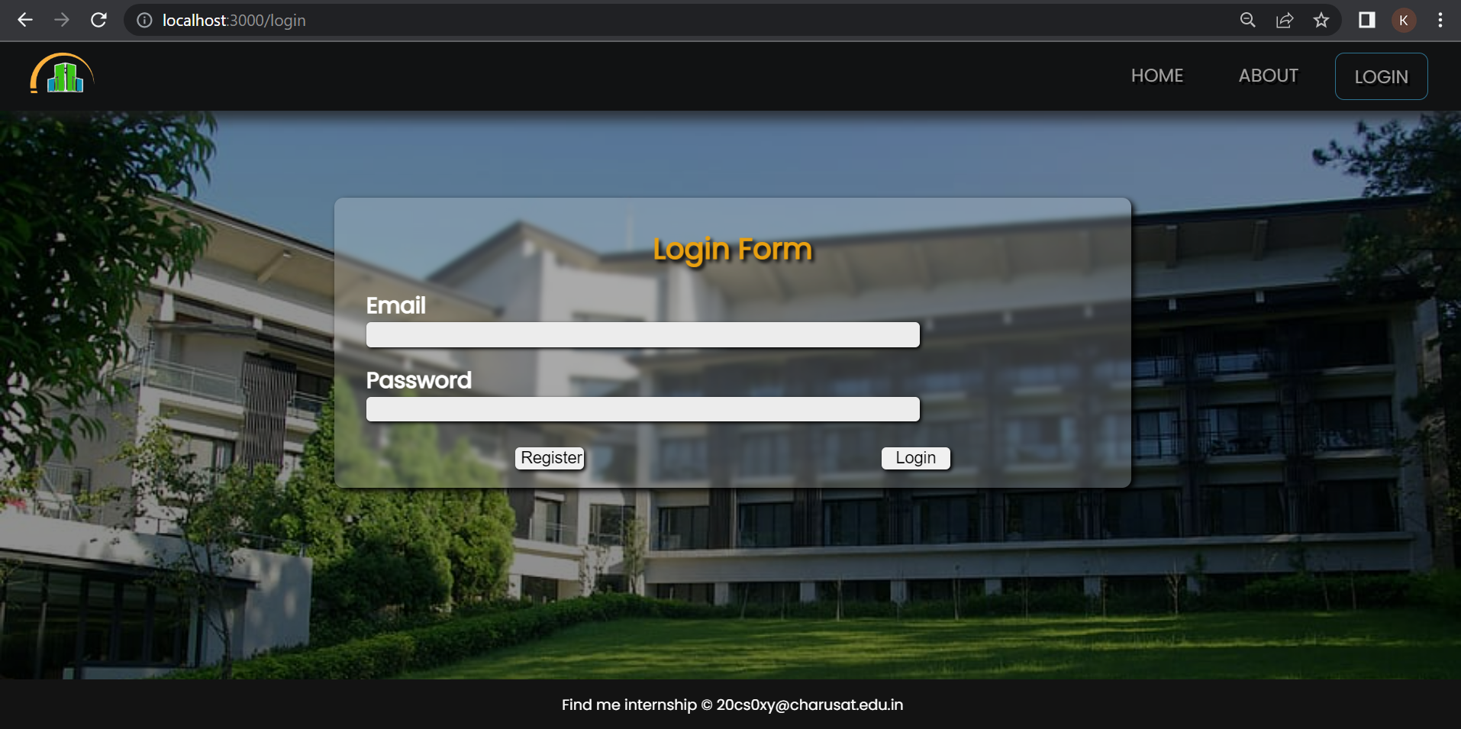
Student login

Slide 18
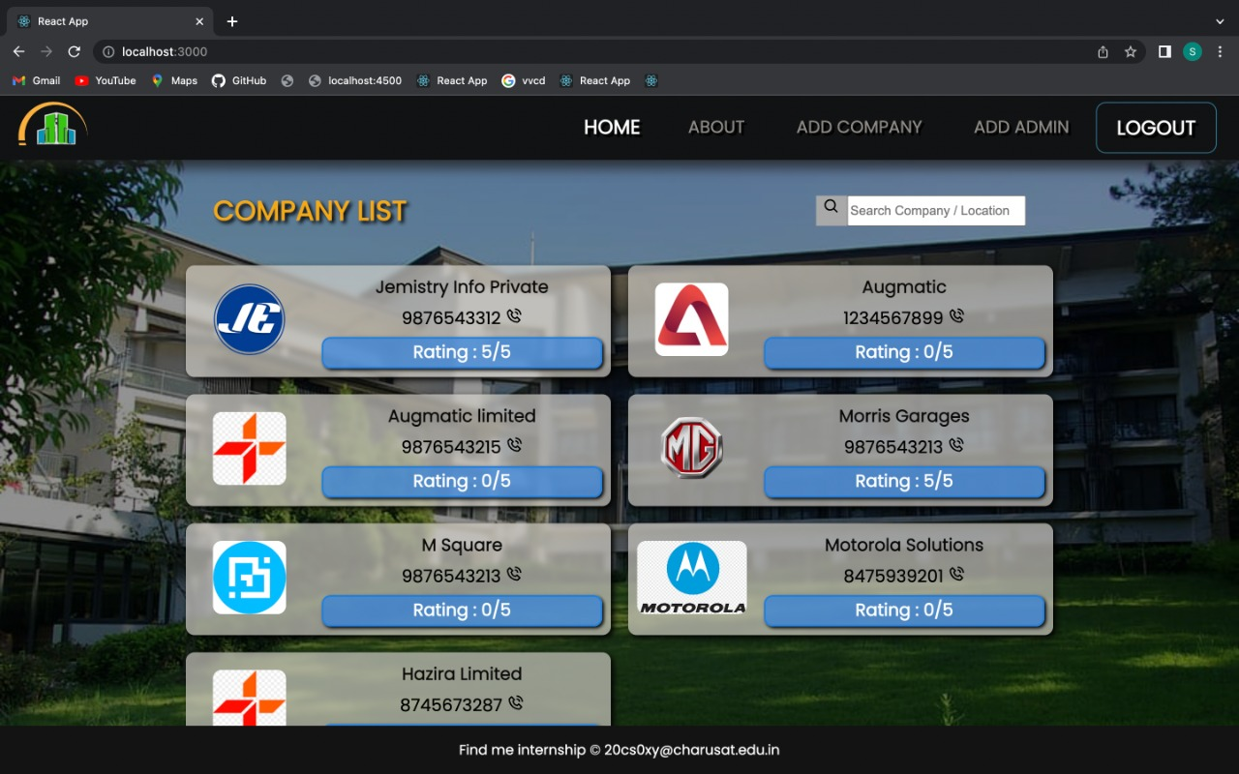
Company list

Slide 19
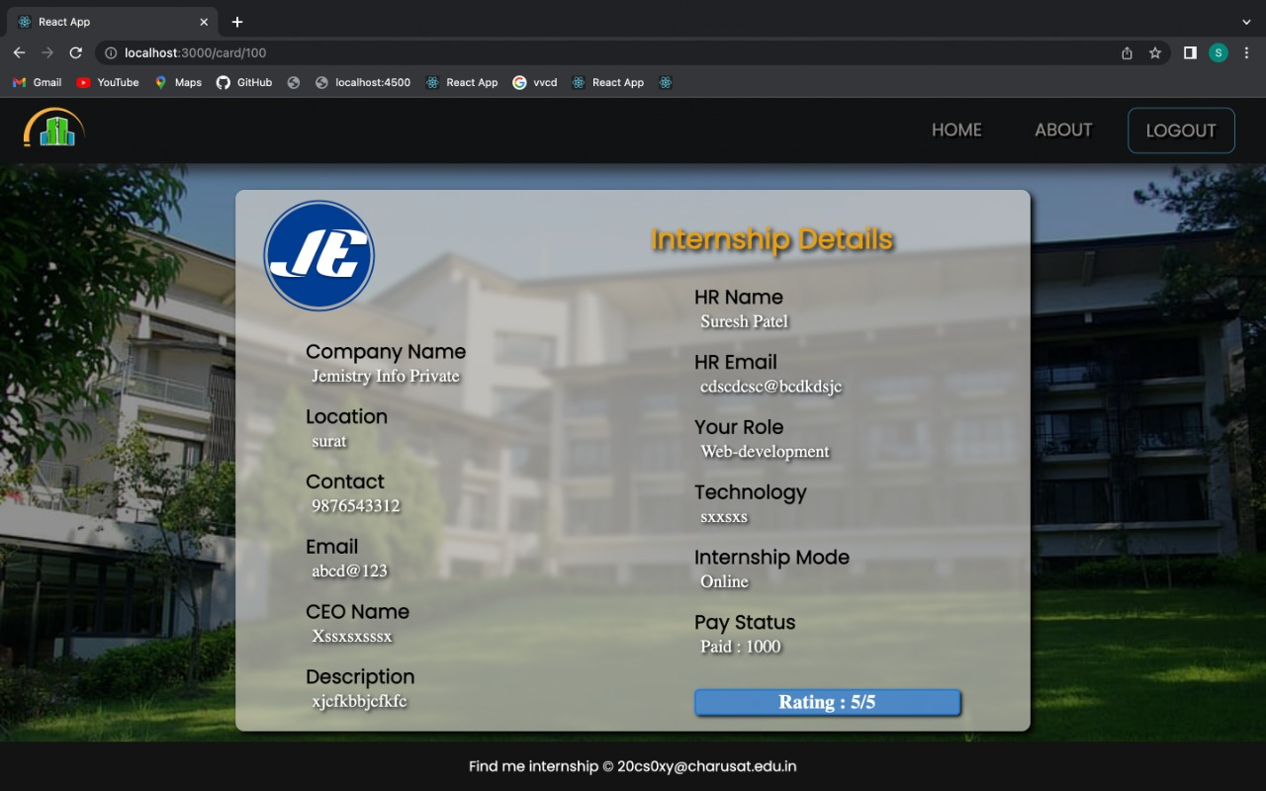
Company profile

Slide 20
Technology to be used
Frontend:
React JS, Bootstrap
Backend:
Node JS (Express JS)
Database:
My SQL

Slide 21
Thank
You
20CS057 Shivam Patel
20CS063 Hemil Patoliya
20CS065 Kishan Prajapati
20CS068 Pruthvi Raj

